Slide 1
Code and Load
Presented by Cosairus Software Engineering, LLC
March 10th, 2020 @ UWG

Slide 2
Overview
Open Visual Studio
Introductions
Download the Project, Run the Web Application
Add some features, run some tests, fix some bugs
Discuss the technologies, tools
QA

Slide 3
Introductions
Cosairus Software Engineering, LLC in Atlanta, GA
Software Development and Consulting
Founded 1996
32 Employees
Microsoft Technology Stack
Clients in Medical, Staffing, Payroll, Finance, and Government

Slide 4
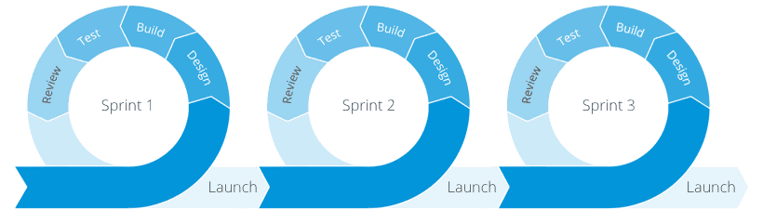
Agile Development Process
Individuals and interactions over processes and tools
Working software over comprehensive documentation
Customer collaboration over contract negotiation
Responding to change over following a plan

Slide 5
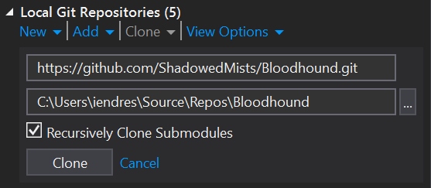
Clone the Project
Open Team Explorer (View > Team Explorer) (Ctrl+/, Ctrl+M)
Choose Clone
https://github.com/ShadowedMists/Bloodhound.git
Clone
Double-Click Bloodhound.sln
Start Debugging (F5)

Slide 6
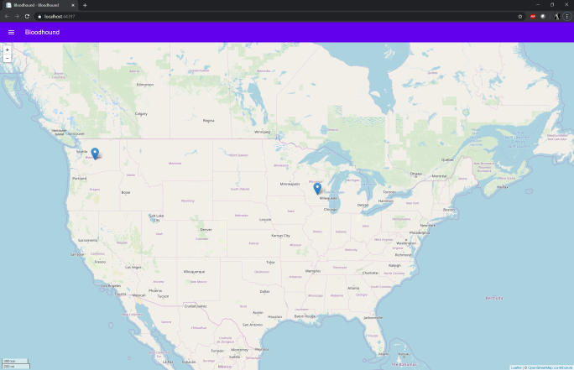
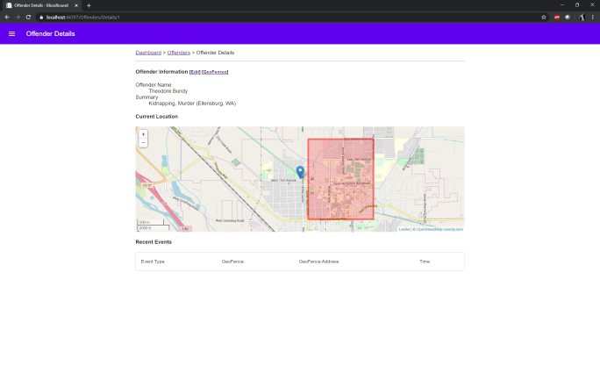
Should Look Like This
Bloodhound – Offender Tracking and Management

Slide 7
Jira Ticket BHD-23 – Add Events for Entry/Exit
Definition:
When an offender enters or leaves a GeoFence assigned to them, the system will create an Entry or Exit event with the location information, the GeoFence that was affected, and the time of when the event occurred.
Acceptance Criteria:
When a new location is submitted, if the offender enters or leaves a GeoFence, a new OffenderEvent record is created linking the location and GeoFence.
The Web Application will show top 10 recent events on the Offender’s Details page, ordered by most recent, descending.
Functionality for creating OffenderLocation and OffenderEvent records is unit tested for correctness.

Slide 8
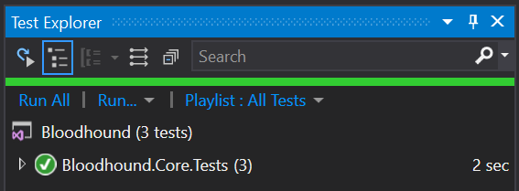
BHD-23 – Development – Adding Events
Open Bloodhound.Core/Workflows/OffenderNewLocationWorkflow.cs
Complete the functionality in AddNewLocation(decimal, decimal, DateTimeOffset)
Add the OffenderLocation to the database
Loop through the Offender’s GeoFences
If the last location is in the GeoFence and the current location is outside the GeoFence, create an Exit event
If the last location is outside the GeoFence and the current location is in the GeoFence, create an Entry Event
Use the OffenderGeoFence.IsInside(decimal, decimal) method to determine if the a location is inside the fence or not
Once complete, Save All, run all unit tests.
File > Save All (Ctrl-Shift-S)
Test > Run > All Test (Ctrl-R, A)

Slide 9
BHD-23 – An Implementation
// add the location to the database
OffenderLocation currentLocation = new OffenderLocation()
{
OffenderId = this.offender.OffenderId,
Latitude = latitude,
Longitude = longitude,
LocationTime = locationTime
};
this.dbContext.OffenderLocations.Add(currentLocation);
this.dbContext.SaveChanges();

Slide 10
BHD-23 – An Implementation
foreach (OffenderGeoFence fence in this.geoFences) {
// determine if the last and current locations are inside the fence
bool lastLocationIsInside = fence.IsInside(this.lastLocation);
bool currentLocationIsInside = fence.IsInside(currentLocation);
int? eventTypeId = null;
// determine if there is an entry or exit
if (lastLocationIsInside && !currentLocationIsInside)
eventTypeId = EventTypeIdentifiers.Exit;
else if (!lastLocationIsInside && currentLocationIsInside)
eventTypeId = EventTypeIdentifiers.Entry;
// if we set the value, add a new event
if (eventTypeId.HasValue) {
this.dbContext.OffenderEvents.Add(new OffenderEvent() {
OffenderId = this.offender.OffenderId,
OffenderGeoFenceId = fence.OffenderGeoFenceId,
OffenderLocationId = currentLocation.OffenderLocationId,
EventTypeId = eventTypeId.Value
});
this.dbContext.SaveChanges();
}
}

Slide 11
BHD-23 – Development – Showing Events
Open Bloodhound/Models/OffenderDetailModel.cs
Add a new public property called Events that is a List<OffenderEvent>
public List<OffenderEvent> Events { get; set; }
On Initialize, select the top 10 events, ordered by time descending, and include the GeoFence and Offender objects
this.Events = dbContext.OffenderEvents.Include(x => x.OffenderGeoFence).Include(x => x.EventType).Where(x => x.OffenderId == this.Offender.OffenderId).OrderByDescending(x => x.CreatedOn).Take(10).ToList();
Open Bloodhound/Views/Offenders/Details.cshtml and remove the @* *@ comments around the heading Recent Events
Save All (Ctrl-Shift-A) and Debug (F5)

Slide 12
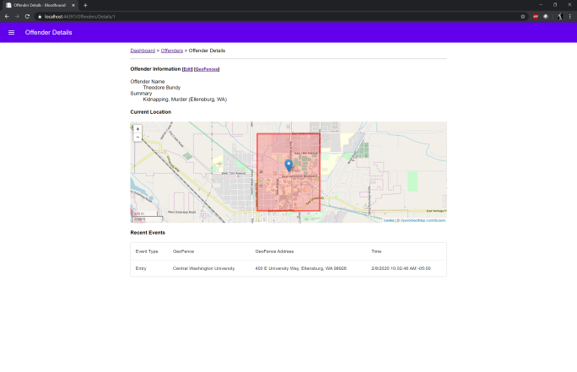
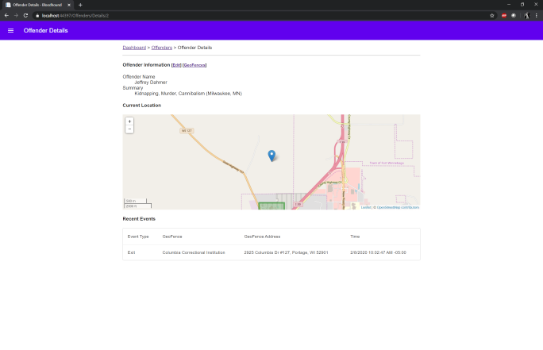
BHD-23 – Testing
Start Debugging (F5) and verify that the offenders have moved and have events displaying in the web application

Slide 13
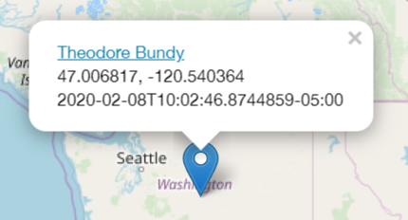
Client Email Alert!
From: Karen
Subject: Times on the Locations
Hey, I was in the demo environment and I noticed that the little popups have this weird time and its not really useful, like I can’t event read that. Here’s a screen-cap:

Slide 14
Client Request: Meaningful Times
Ask: present Date and Time information in a meaningful format to the user
Modify Bloodhound.Core/Model/v_OffenderLastLocation.cs
public string RelativeTime { get => TimeFormatter.FormatRelative(this.LocationTime); }
Update JavaScript references from LocationTime to Relative time:
Bloodhound/Views/Offenders/Details.cshtml, Line 100
Bloodhound/Views/Home/Index.cshtml, Line 29
Save All (Ctrl-Shift-A) and Debug (F5)

Slide 15
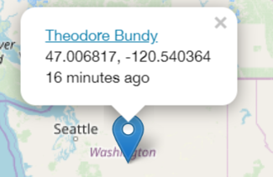
Testing
Verify on the Dashboard and Offender Details pages that popups display the relative time

Slide 16
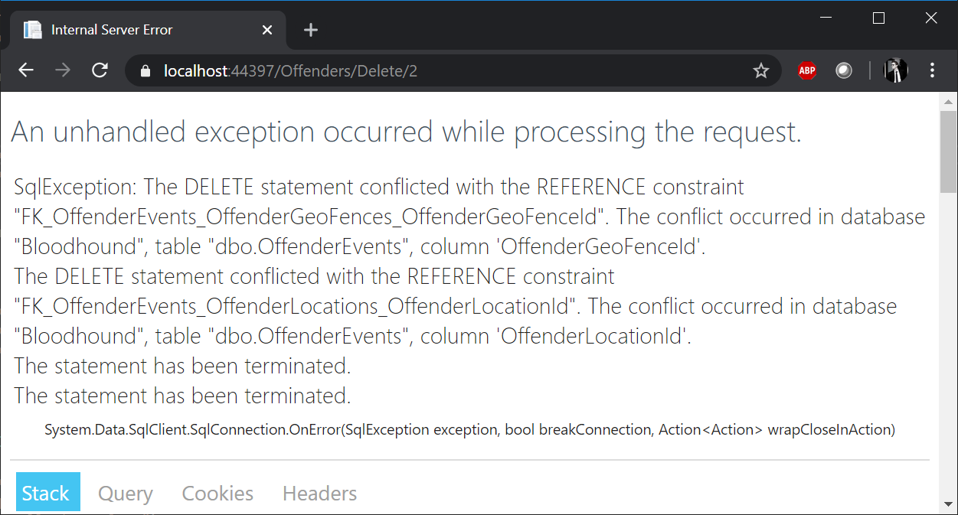
Client Email Alert!
From: Karen
Subject: Another Error
I got another error while testing in the demo environment. I was trying to delete a test offender I made. I just don’t get why there are so many bugs in the code!

Slide 17
Client Request: Resolve the Foreign Key Error
Open Bloodhound.Schema/dbo/Stored Procedures/p_Offender_Delete.sql
Add the statement to delete OffenderEvent records before deleting GeoFences
delete from OffenderEvents where OffenderId = @OffenderId
Right click Bloodhound.Schema and select Schema Compare, then Compare
Ensure that the Source is Bloodhound.Schema and the target is your database
Server = (localdb)\MSSQLLocalDB, Database Name = Bloodhound
Click Update
Save All (Ctrl-Shift-A) and Debug (F5)

Slide 18
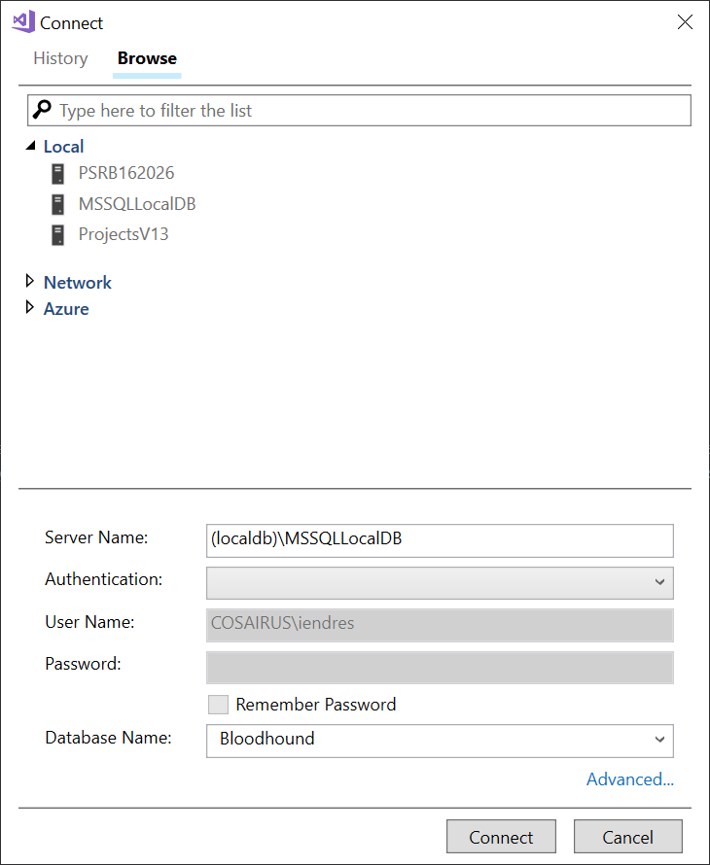
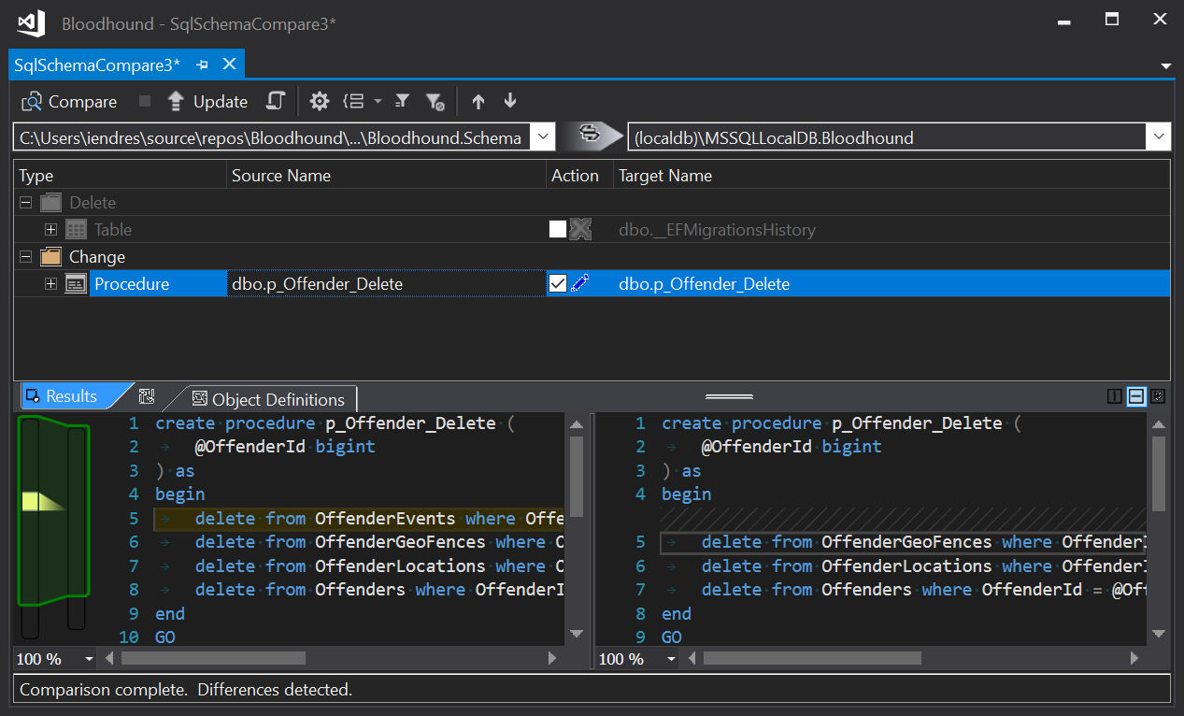
Client Request: Schema Comparison

Slide 19
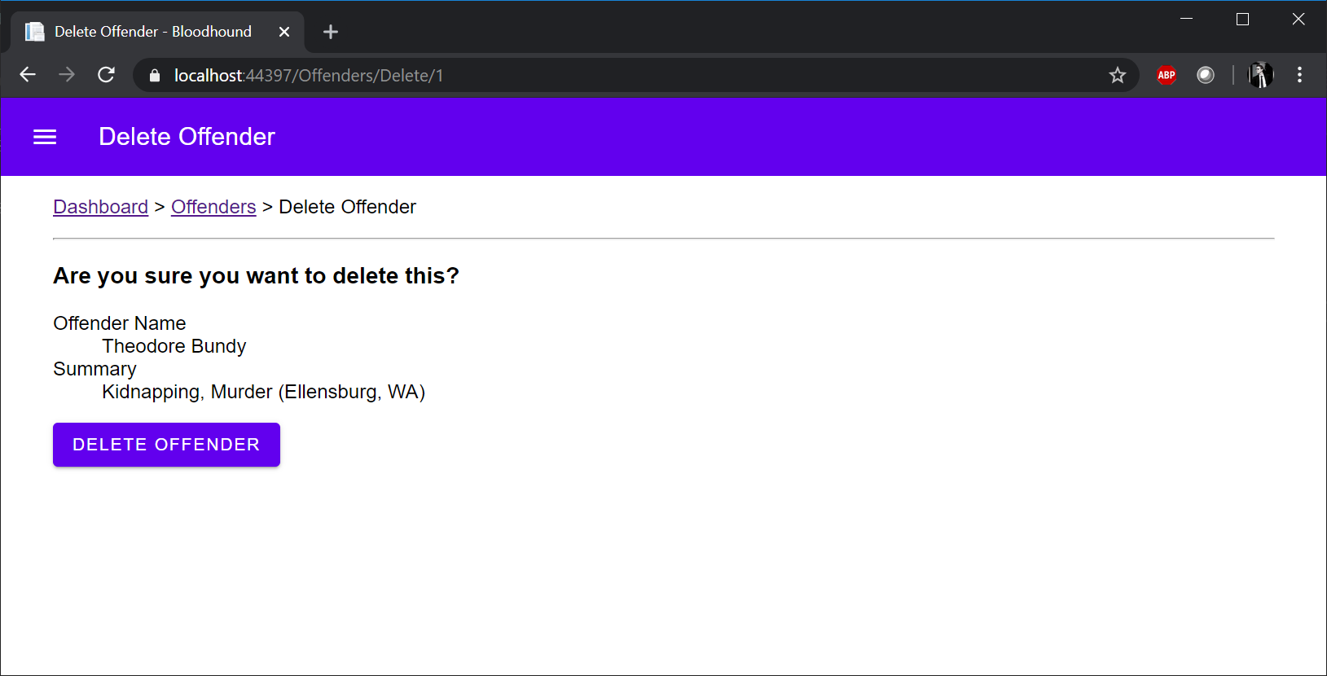
Client Request: Test

Slide 20
Technology and Tools
Microsoft Visual Studio 2017
Microsoft ASP.NET Core MVC 6
ASP.NET Core 2.1
Microsoft SQL Server Data Tools 2017
Microsoft SQL Server Express LocalDB
Microsoft Entity Framework Core

Slide 21
Design Patterns Used
Model View Controller (MVC)
Model View View-Model (MVVM)
Data Context Interaction (DCI)
Data Transfer Objects (DTO)
Inversion of Control/Dependency Injection

Slide 22
QA – Open Questions

Slide 23
The End
Thanks for your participation!

